Slide 1
MIT STUDENT HUB WEBSITE
Amal jose
Tapan vyas
Kirpalpreet kaur
Supervisor’s,
Dr. Fadi Fayez & Dr. Rizwan Ahmad

Slide 2
MIT STUDENT WEBSITE
AIM - Develop a website for MIT students to interact and share information
Develop a webpage to list out job board, accommodation available, transportation facilities (car pool, share ride ) , cultural events and activities for internationals and natives
SCOPE - Convey adequate resources to students of MIT.
Project description -Indeed there is usefull information about the MIT’s environment on official website but we are implementing a webpage specially for the students to get information of social activities, opportunities and availability. However students will also have access to update the information related to social events, accomodation, transportation and job opportunities.

Slide 3
Added values, mov(s)
1. job availabilities, accommodation, transportation features
2. Social and academic impact
3.Easier access to new students
4.More important for internationals

Slide 4
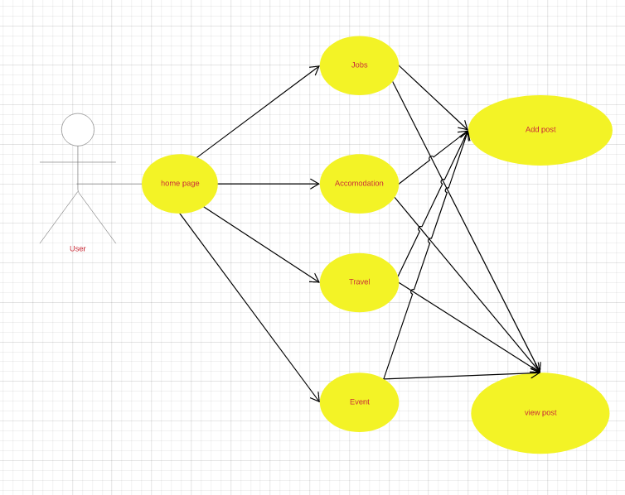
User activity diagram

Slide 5
PLATFORM(S) USED
C# ,VISUAL STUDIO –backend development
HTML,BOOTSTRAP and JAVASCRIPT –frontend design
SQL SERVER 17- database

Slide 6
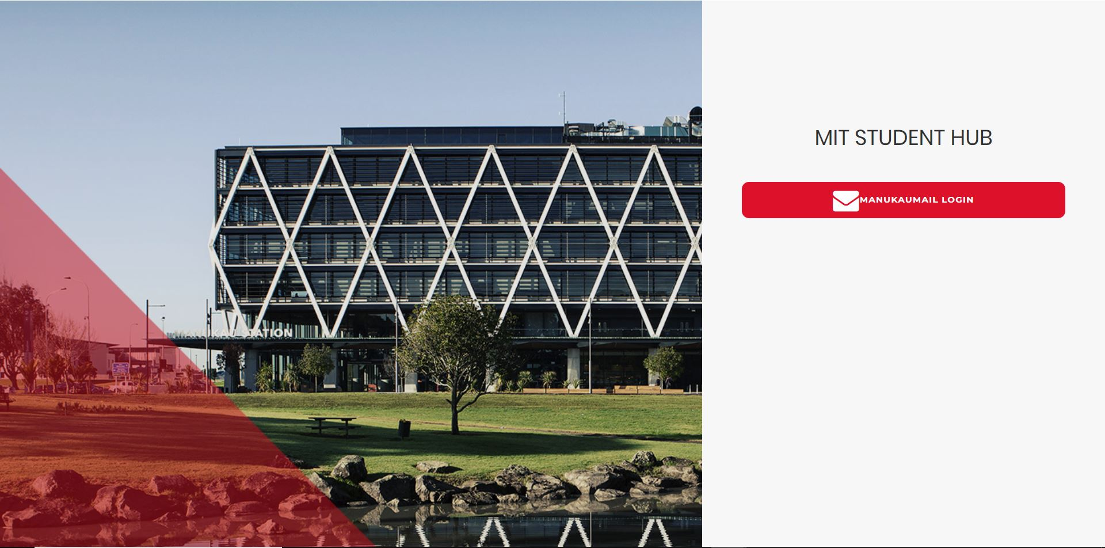
User login page

Slide 7
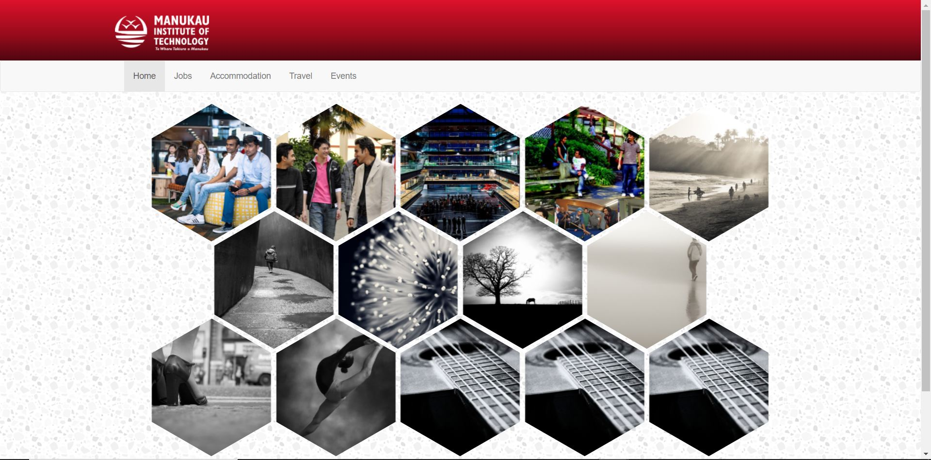
Home page

Slide 8
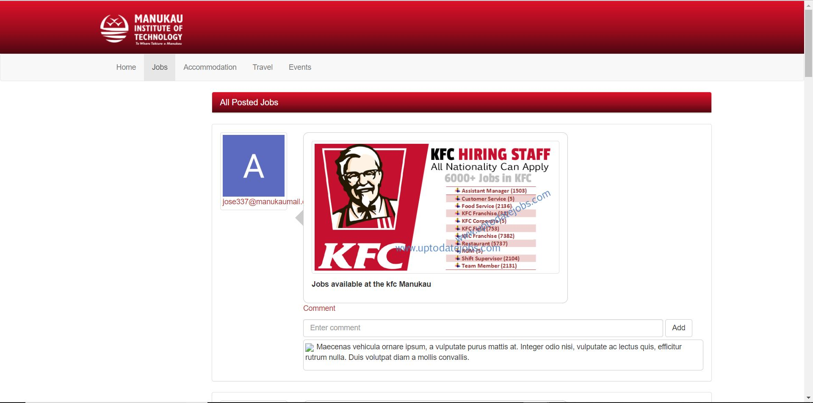
User post

Slide 9
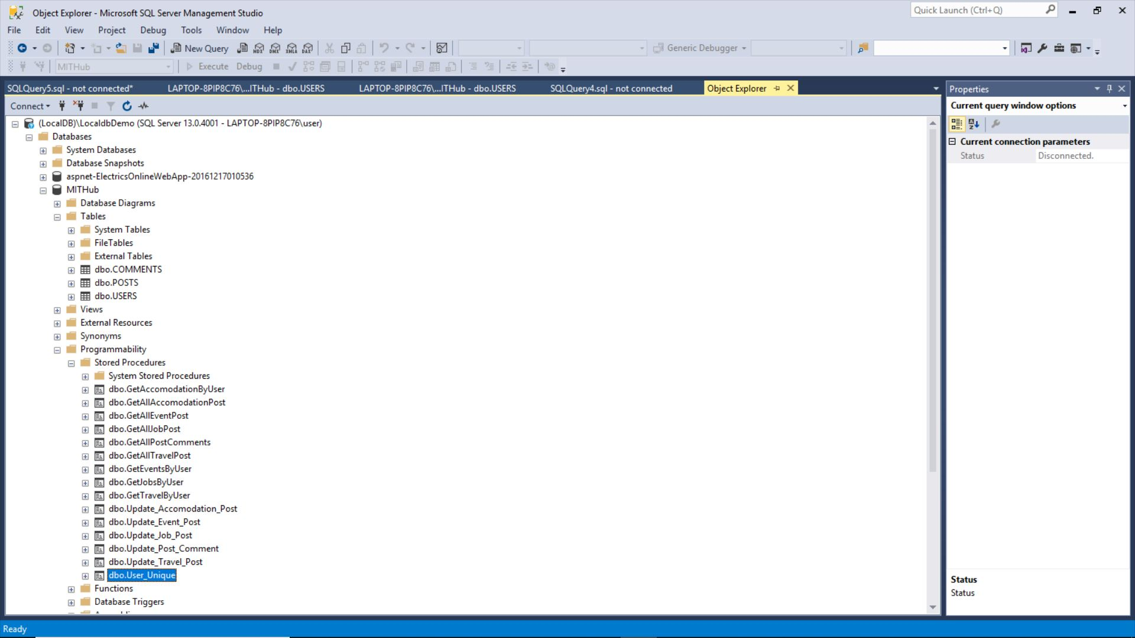
Database
We have used sql server management studio for designing the database.
We created multiple tables and stored procedures for our website

Slide 10
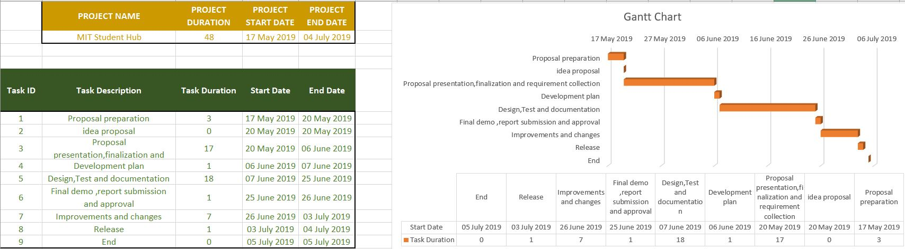
GANTT CHART

Slide 11
DEMONSTRATION

